Slide 1
Presented to you By:
Nate Witte, Victor Mashevsky, Jack Jessen, and Dylan Joelson

Slide 2

How to make calc not suck.

Slide 3
Overcoming nervousness
It's estimated that 40%-60% of all students suffer from critical test anxiety
It's possible that the study isn't lacking knowledge, rather test- taking skills
Good remedies; study skills, organization, bubble gum on test day, going over past exams, building up confidence with practice problems, positive reassurance
Test anxiety workshop by our wonderful tutoring coordinator
(Phan, n.d.)
Notes:
Plug Erikas test anxiety workshop for this, don’t forget that test taking in same room that the test will be in. Same flavor gum on test day as flavor during study

Slide 4

Terms
Function Notation
f(x) or y
Equation of Line
Derivative Notation
  $\frac{dy}{dx} \frac{d}{dx}$ $\frac{d}{dt}$ f’(x)
Concept of Limit

Slide 5

Functions
Function is just a machine with an input and an output
Start simple, $f(3)$, build to variables
Lots of beginners struggle with f(x), y. These are just synonyms!
f(x)
input
output

Slide 6


Functions Examples
Start with an Easy Example:
$$f\left(3\right)=\frac{1}{2}x+2$$
$$y= \frac{1}{2}3+2$$

Slide 7
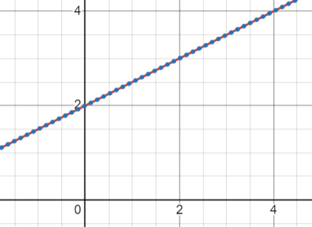
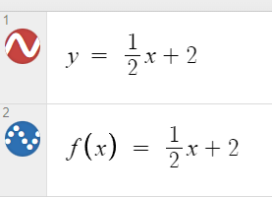


Functions Examples
Start with an Easy Example:
$$f\left(x\right)=\frac{1}{2}x+2$$
$$y= \frac{1}{2}x+2$$

Slide 8

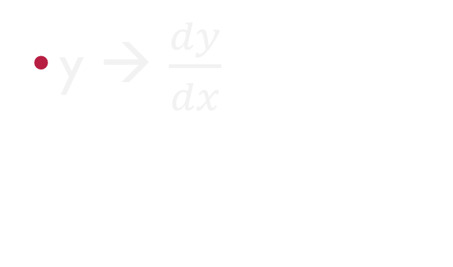
Derivative Notation
$\frac{d}{dx}$ $\frac{d}{dt}$ ???
y → $\frac{dy}{dx}$
f(x) → f’(x)
What Do they all mean?!?

Slide 9

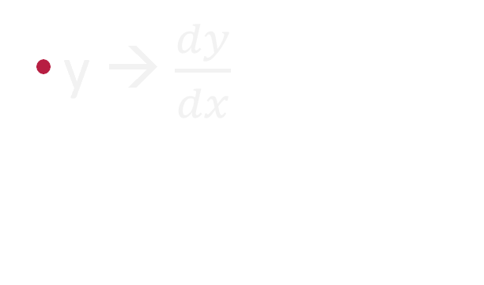
Derivative Notation
$\frac{d}{dx}$ $\frac{d}{dt}$ ???
y → $\frac{dy}{dx}$
f(x) → f’(x)
THEY ARE THE SAME THING (Basically…)

Slide 10





Derivative Notation
$\frac{d}{dx}$ $\frac{d}{dt}$ ???
y → $\frac{dy}{dx}$
f(x) → f’(x)
  Typical Form: $\text{f}\text{(}\text{x}\text{) = }x^{2}+3$→ $\text{f}\text{′}\text{(}\text{x}\text{) = }2x$
$\frac{d}{dx}$ often seen as $\frac{d}{dt}$
  Typical Form: $\text{y}\text{ = }x^{2}+3$→ $\frac{d}{dx}\text{(}\text{y}\text{)}\text{ = }2x$
  Related Rates: $\text{V}\text{ = }x^{2}+3$→ $\frac{d}{dt}\text{(}\text{V}\text{)}\text{ =} 2x\frac{d}{dt}\text{(}\text{x}\text{)}$ → $\frac{dV}{dt}\text{ =} 2x\frac{dx}{dt}$ → $V′\text{ =} 2xx′$
Used for Partial Differential Equations
  Typical Form: $\text{y}\text{ = }x^{2}+3$→ $\text{d}\text{y}\text{ = }2x dx$ →$\frac{dy}{dx}\text{= }2x$

Slide 11
Derivative Notation
All Represent Derivatives and are Interchangeable
Different Situations Different Types of Problems
Reiterate and Remain Consistent
Derivative is Slope of the Tangent Line

Slide 12
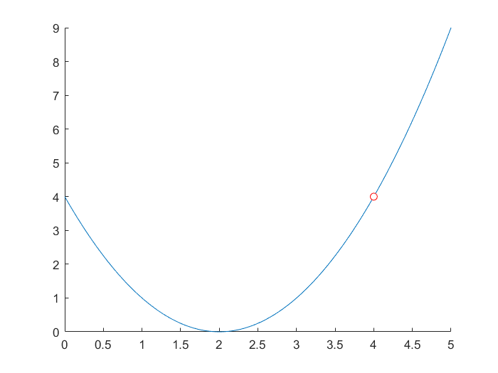
Limits
Graphs are often helpful to quantify the “approaching” aspect of limits.

Slide 13

Limits
Sometimes it can be helpful to slightly bend the strict “correct” way of interpreting something to make it easier to understand
$\lim_{x→3}\left(\frac{1}{x}\right)=\frac{1}{3}$; “plug 3 in for x” despite that not being technically correct
For limits at infinity, talk about $∞$ as a number that is always increasing
$\lim_{x→∞}\left(\frac{1}{x}\right)=0$; can be helpful to write out the pattern as x increases: $\frac{1}{2}>\frac{1}{3}>\frac{1}{1000}$ etc.

Slide 14
Overall Takeaways
Make sure to ask explorative questions to make sure you’re teaching at the right level
Remember that all the jargon used in Calc is not as familiar to the tutee and reiterate often
Don’t be afraid to go back to basics if the tutee needs it, but be sensitive about it.

Slide 15
Thank you
Victor Mashevsky
Nathan Witte
Jack Jessen
Dylan Joelson

