Slide 1
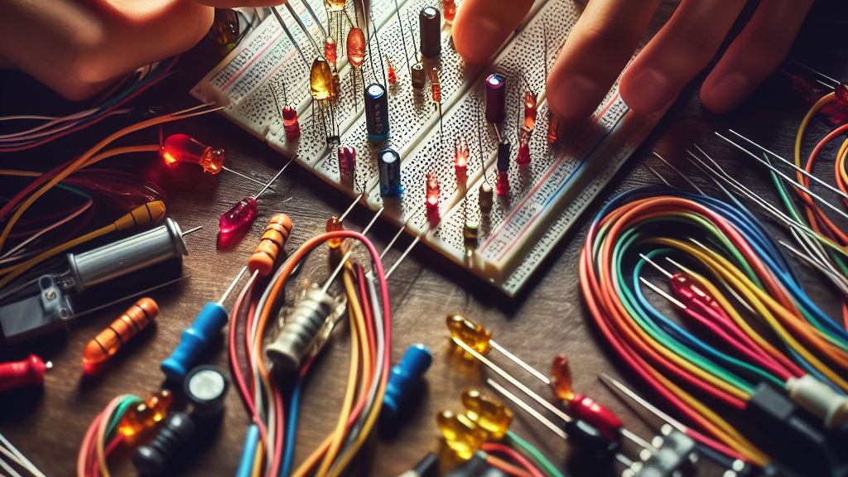
Pre-Intro to Circuits and Electronics
Prepared by: Dayton Huffaker, Jasen Nicolas, Cyrus Khaleeli

Slide 2
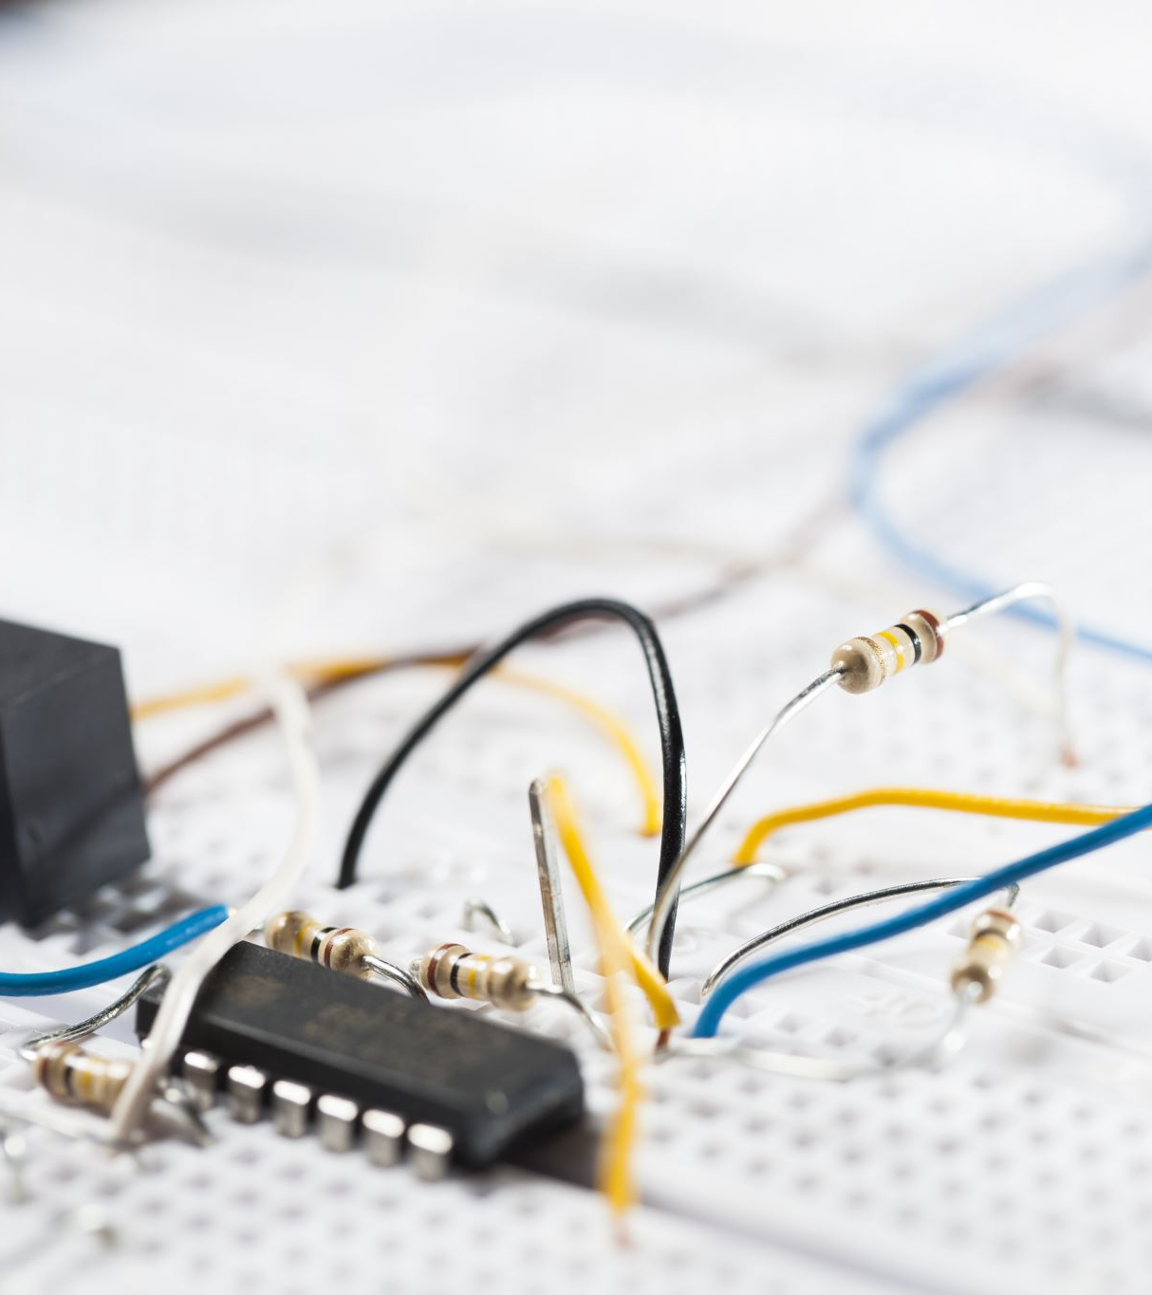
Table of Contents
Intro to circuits
How to measure circuit properties
Large vs. Small signal
Basics of Diodes, BJTs, MOSFETS
Intuitive understanding of coding in Arduino IDE
Magnetism

Slide 3
What is electricity?
We can think of Voltage and Pressure as equivalents, Current and Flow as equivalents, and line resistance devices as equivalents
Water in a Pipe
Electricity
Voltage Source
ΔV=12 Volts
I=3 Amps
Pump
ΔP=12psi
Q=3gpm
Orifice
ΔP=12psi
Q=3gpm
Resistor
ΔV=12 Volts
I=3 Amps

Slide 4

Circuit Analysis Techniques
Kirchhoff’s Voltage Law (KVL)
Kirchhoff’s Current Law (KCL)
Nodal Analysis – fan favorite
Superposition
Loop/Mesh

Slide 5
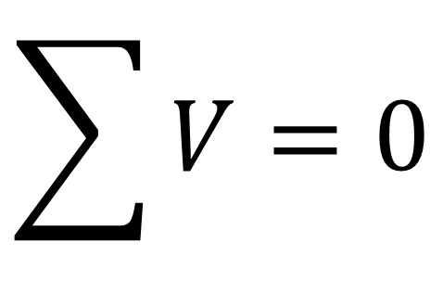
Kirchhoff’s Voltage Law (KVL)
The sum of the individual voltage differences in a loop are equal to zero
Can think of it like an energy balance equation. What comes in must go out
$$\sum{V=0}$$

Slide 6
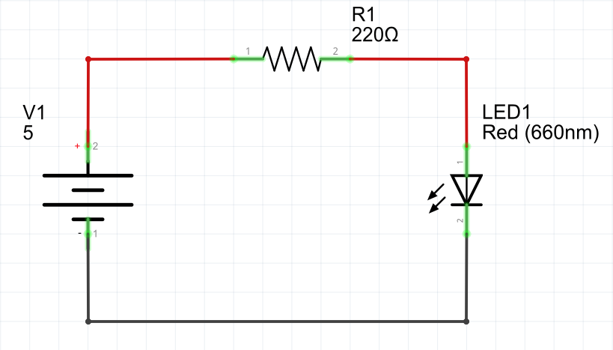


KVL Example
I1R1
v1
vD
$$0=+v_{1}−I_{1}R_{1}−v_{D} or 0=−v_{1}+I_{1}R_{1}+v_{D}$$

Slide 7
How to Measure Circuit Properties

Slide 8
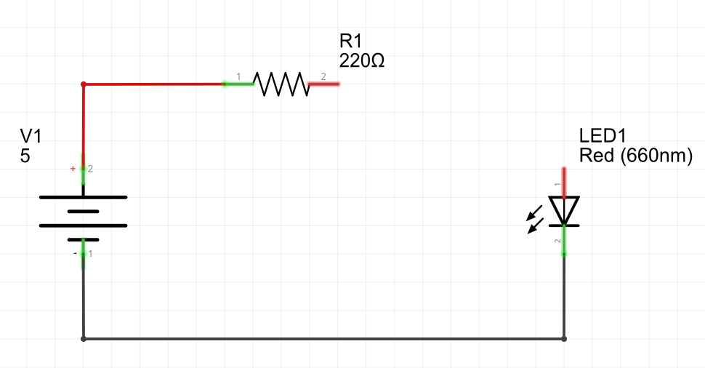
How to Measure Circuit Properties
Current Measurement:
  Connect in series with the circuit

Slide 9
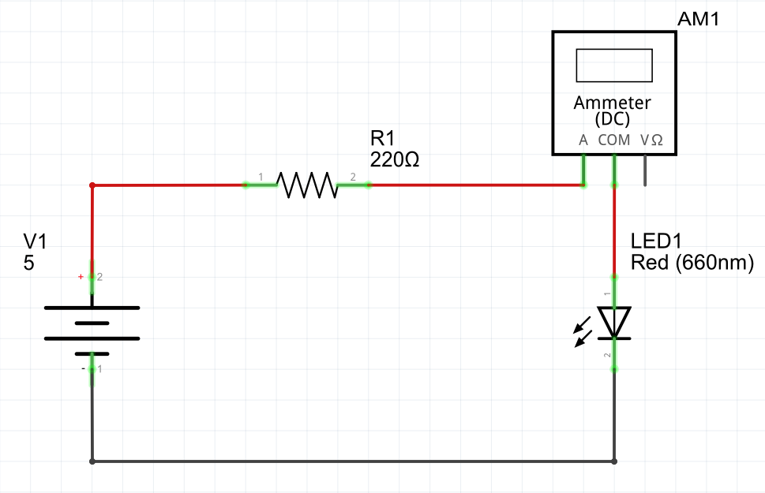
How to Measure Circuit Properties
Current Measurement:
  Connect in series with the circuit

Slide 10
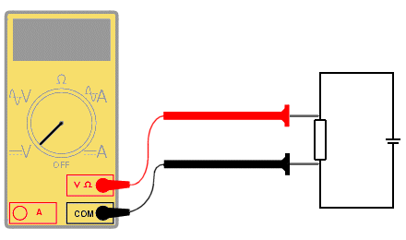
How to Measure Circuit Properties
Voltage Measurement:
  Connect in parallel with the circuit
  Red (positive) lead connects to point of higher potential
  Black (negative) lead connects to point of lower potential
  It is important to remember that the measured voltage is relative to the black (negative) lead

Slide 11
Large vs. Small Signal
DC and AC signals with fancy wording.
Large signal = DC
  Subscripts are capitalized ex: iD, vBE
Small signal = AC
  Subscripts are lowercase ex: ic, vin
Can have a power source that has both large and small signal components
  When solving these problems, you separate the two

Slide 12
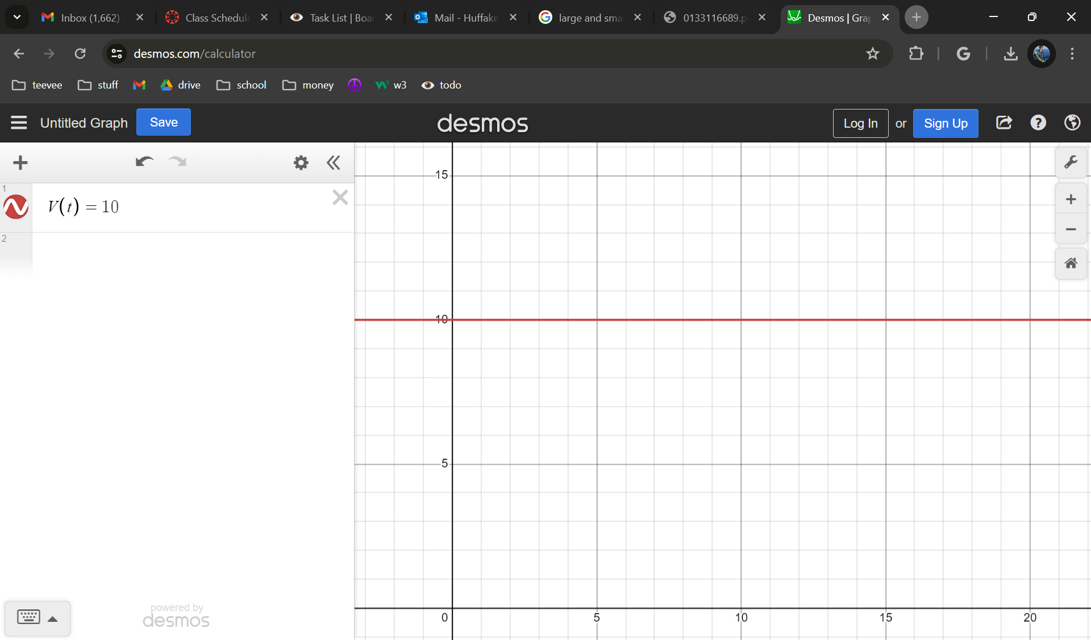
Large Signal
Voltage
Voltage stays at a constant 10V throughout the time period
Time

Slide 13
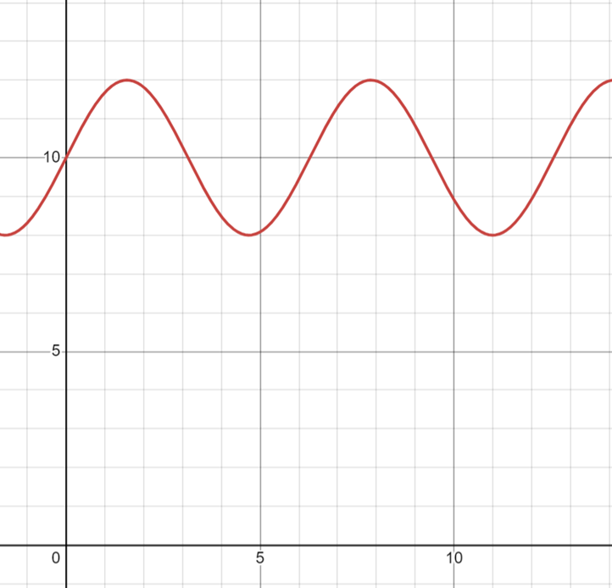
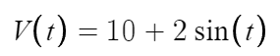
Large and Small Signal
Voltage
Voltage average is 10V, but “wiggles” around it due to the 2VAC source
Notice that it changes by 2V in both directions from 10V (8V to 12V)
Time

Slide 14
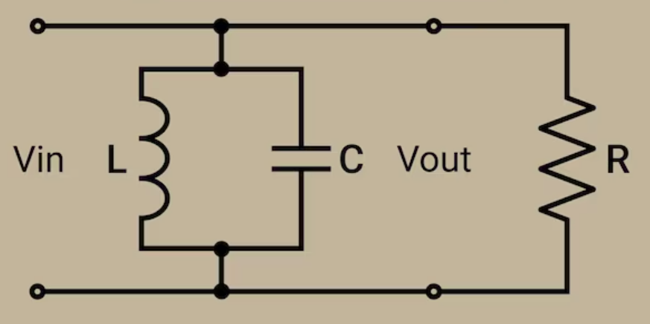
Component Reactions: Large Signal
Capacitor: “Open circuit.” No change in voltage to create a current
Inductor: “Short circuit.” No change in current to create a voltage

Slide 15
Component Reactions: Small Signal
Use complex circuit analysis techniques to solve for these. V=IZ.
Remember that:
ZR = R
ZC= 1/(jωC)
ZL=jωL
Some components have specific small-signal equivalents

Slide 16
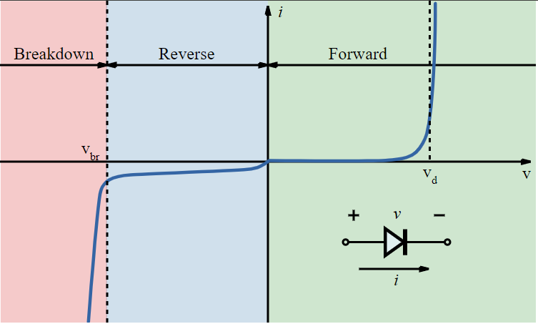
Diodes
Allows current to flow in one direction.
Fluids analogy: Think of a check valve!
Zener Diode: has a set voltage at which point current can flow in the other direction, known as the breakdown region

Slide 17
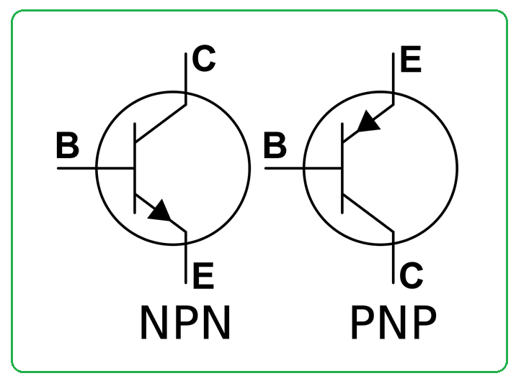
Bipolar Junction Transistors (BJT)
Can think of it like a current controlled switch
The amount of current you put into the (B)ASE is proportional to the amount that you achieve from the (C)OLLECTOR to the (E)MITTER
Fluids analogy: acts like an eductor (remember the venturi effect?)

Slide 18
BJTs continued
Important equations:
ie=ib+ic
ic=ϐib
  ϐ is a scale factor for your collector current
npn is “normally-open”
pnp is “normally-closed”
ic
Relatively small input ib
ie

Slide 19
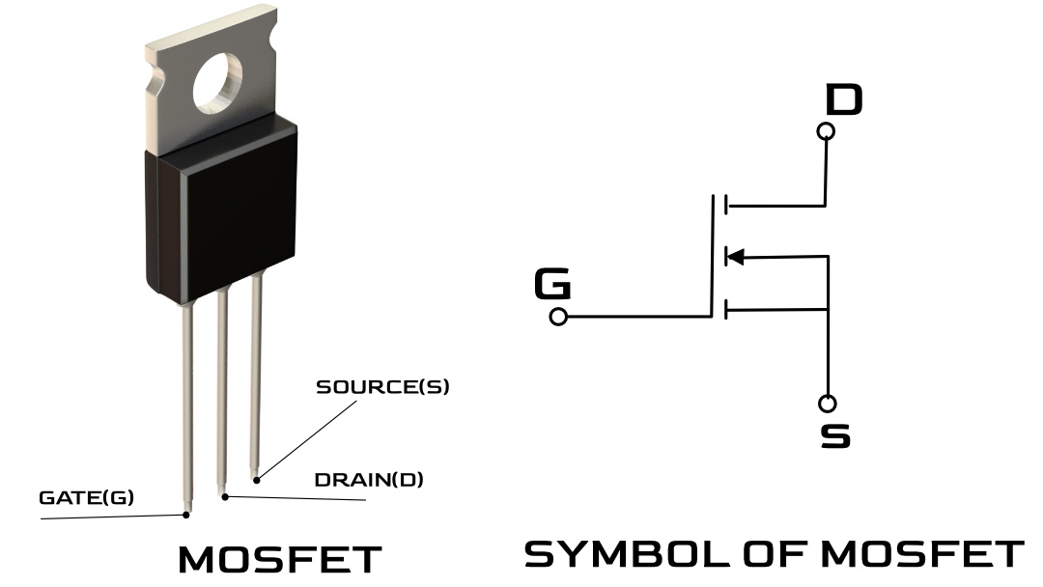
Field Effect Transistors (FET)
Voltage controlled switch
Supply a predetermined voltage to the (G)ATE to “close” or “turn on” the switch between the (D)RAIN and (S)OURCE
Think of it like a switch but instead of using your hand you use a voltage

Slide 20


$$v_{DS}$$
$$v_{GS}$$

Slide 21

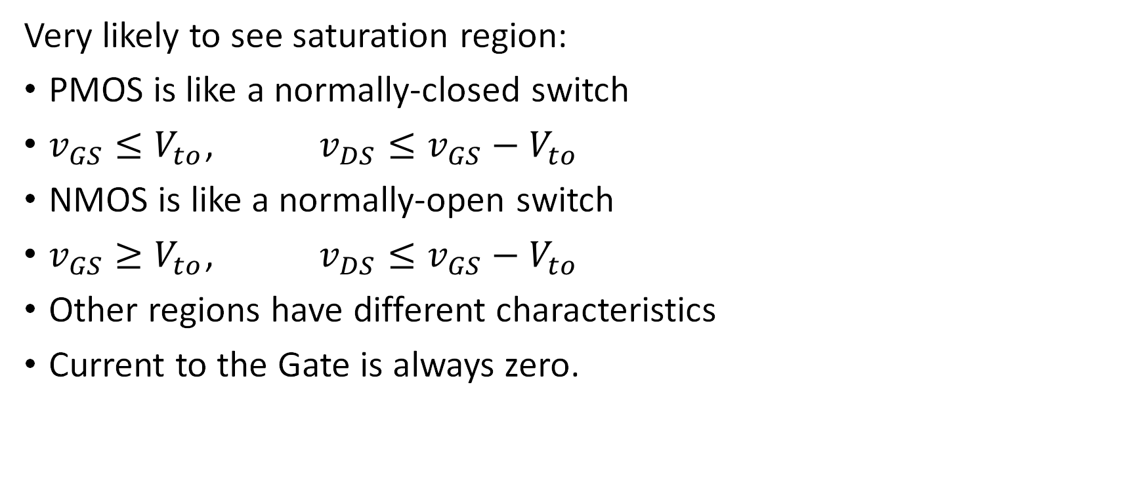
Important MOSFET Notes
Saturation Region Drain Current:
Very likely to see saturation region:
PMOS is like a normally-closed switch
$v_{GS}≤V_{to}$, $v_{DS}≤v_{GS}−V_{to}$
NMOS is like a normally-open switch
$v_{GS}≥V_{to}$, $v_{DS}≤v_{GS}−V_{to}$
Other regions have different characteristics
Current to the Gate is always zero.
$$i_{D}=K{\left(v_{GS}−V_{to}\right)}^{2}$$

Slide 22

Intuitive Understanding of Coding in Arduino IDE
Code controls various input and output devices

Slide 23
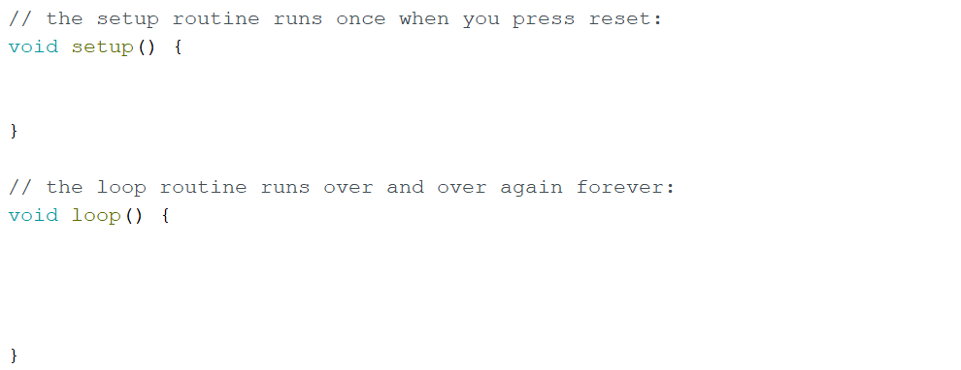
Basic Code Organization as an Example: Going on a Run

Slide 24
Basic Code Organization as an Example: Going on a Run
Define initial properties here!
Ex: Tie your shoes and stretch.

Slide 25
Basic Code Organization as an Example: Going on a Run
Define initial properties here!
Ex: Tie your shoes and stretch.
Repeated operations go here!
Ex: Take a step forward.
After reaching the “},” it will return to void loop(); and start again line-by-line in the same order.

Slide 26
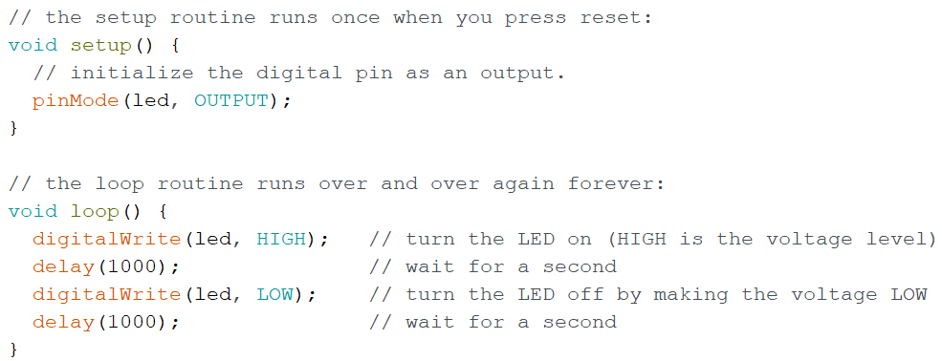
Example Code: Blink

