Slide 1

How to Prep for your Mates Exam
By the MT Tutors
Jake Banich, Josh Kuiper, David Richardson, Joey Simone, Malcolm Veach
Notes:
Josh
Description of deliverable: Students preparing to take MT License exams should be able to look at this document and be able to organize their studying in an efficient way. The first part of the presentation outlines the timeline for mates study, with focus on the best way to practice problems, memorize certain constants, and keep the mind and body fresh as exam day approaches, with some emphasis on what studying should be done the month, the week, and the night before exams. The second part of the presentation outlines the critical skills and common stumbling blocks pertaining to each of the 7 exams within the mate’s exam block. The ordering of the 7 exams is the order as given in the 2024 January exam session as administered at CMA.
In the first section, we'll delve into a timeline for preparing for your mates' exams efficiently. It's crucial to organize your study approach as per the time available. Let's break it down:

Slide 2
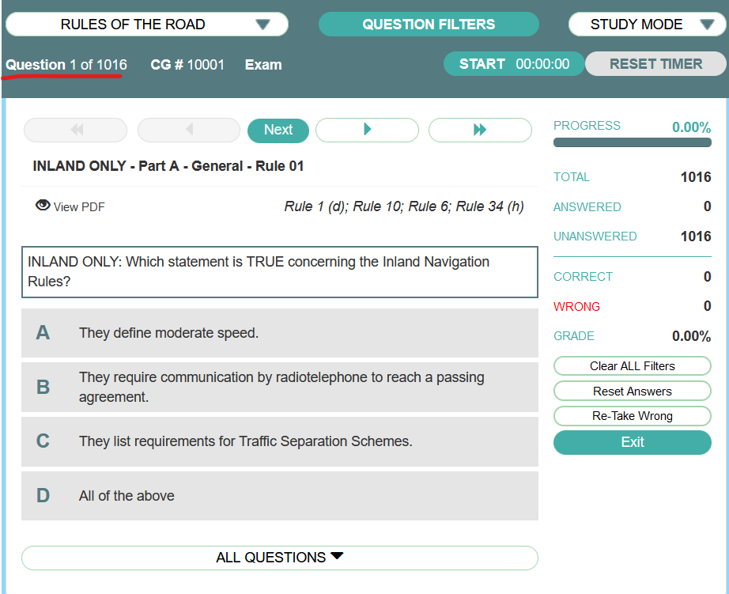
Long Term
Lapware is good for a year and start getting familiarity with the problems. Start early and don't think about shortcuts
3 months before test date begin to review rules of the road question bank. 200 questions a day.
Notes:
Jake
During this phase, your goal is to familiarize yourself with Lapware and its solutions presentation. Avoid taking shortcuts at this stage. Focus on brushing up on the basics and finding efficiency in plotting.

Slide 3
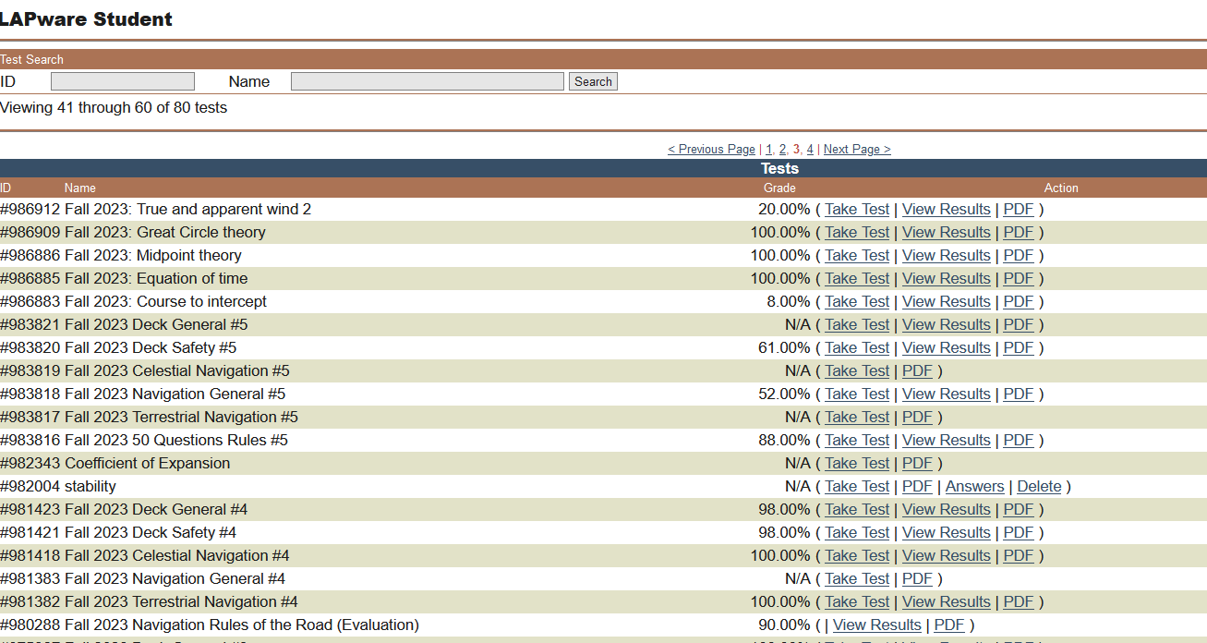
Month Out
Take tests every day.
  At least 1 rules test per day
  Take tests in problem subjects.
  Search for unfamiliar questions in the banks.
Notes:
Joey
As we approach the exam month, daily practice becomes imperative. Take at least one rules test per day and focus on problem subjects. Make use of the question banks to tackle unfamiliar questions. Additionally, start rote work by tackling 200 rules questions daily and memorizing essential information.

Slide 4

1 Week Out
Make enough food in your fridge, the few hours between tests aren't that long.
Make sure that there's nothing going on that can take you out of the environment, do all your chores, make sure your place is suitable for relaxing and studying. Mates is a marathon.
Give each test one more go in lapware.
Notes:
Malcolm
As the exam week draws near, ensure your home environment is conducive to focus. Stock up on essentials, complete chores, and create a comfortable space to study. Conduct a mock-mates exam to simulate real exam conditions.

Slide 5

The Night Before
GO TO SLEEP! DON'T CRAM, SHUT YOUR MOUTH LAY DOWN AND DON'T MOVE FOR ABOUT EIGHT HOURS
Photo ID, Pencils Pens and Erasers, you may bring your own (approved) calculator.
No water or bathroom breaks during test
Coordinate in morning showing up together
Notes:
Josh
The night before the exam, review the NMC Sample Test to reinforce your knowledge and calm any last-minute nerves.

Slide 6
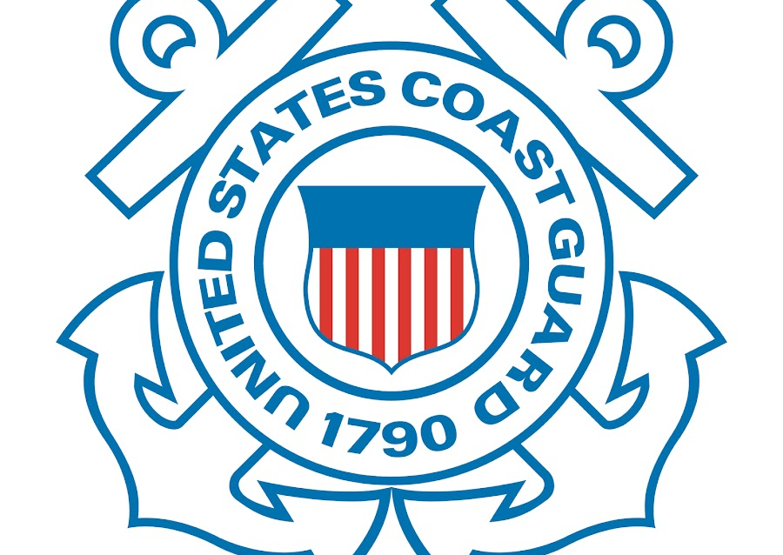
Rules of the Road
Use the lapware function where you can go through the entire question bank at least once
Take 50Q rules quizzes every week and track your improvement
Rules is the first exam, and it sets the tone for the whole week of testing
Can only get 10 wrong
No reference Material Allowed
Notes:
Jake
This is the first exam and sets the tone for the rest of the week. Go through the entire Lapware question bank and take a 50-question Rules Quiz daily to reinforce your understanding.

Slide 7
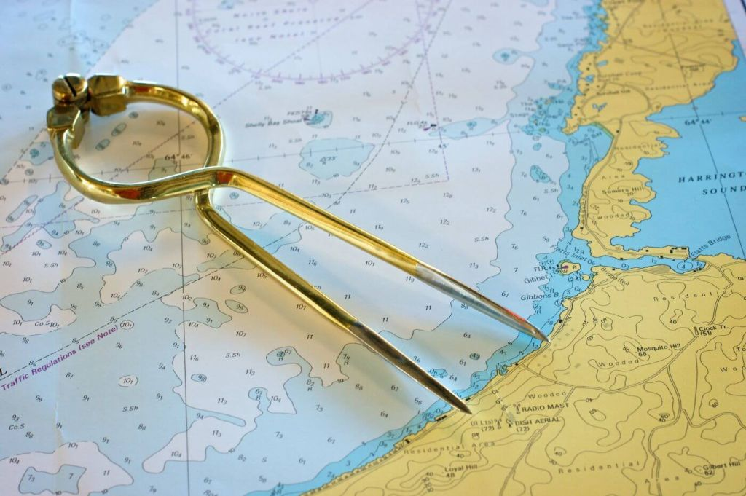
Chart Plot
    Don’t Get Psyched Out
    The plotting isn’t the hard part, it’s the lookups that get you
    It's difficult to prepare for the test because the questions are weird.
      Think about the questions in reverse.
      COAST PILOTS LOOKUPS ARE VERBATIM, CLOSE IS NOT RIGHT
Notes:
Joey
The thing with chart plot that's weird is the one that people freak out about the most because of the high fail rate, but the plotting is not what's hard. People beef the lookups, so practice using the physical coast pilot and light list.
It's difficult
Chart plotting can be daunting, but remember, it's the lookups that can trip you up. Practice thinking about questions in reverse and remember that Coast Pilot lookups must be verbatim.

Slide 8
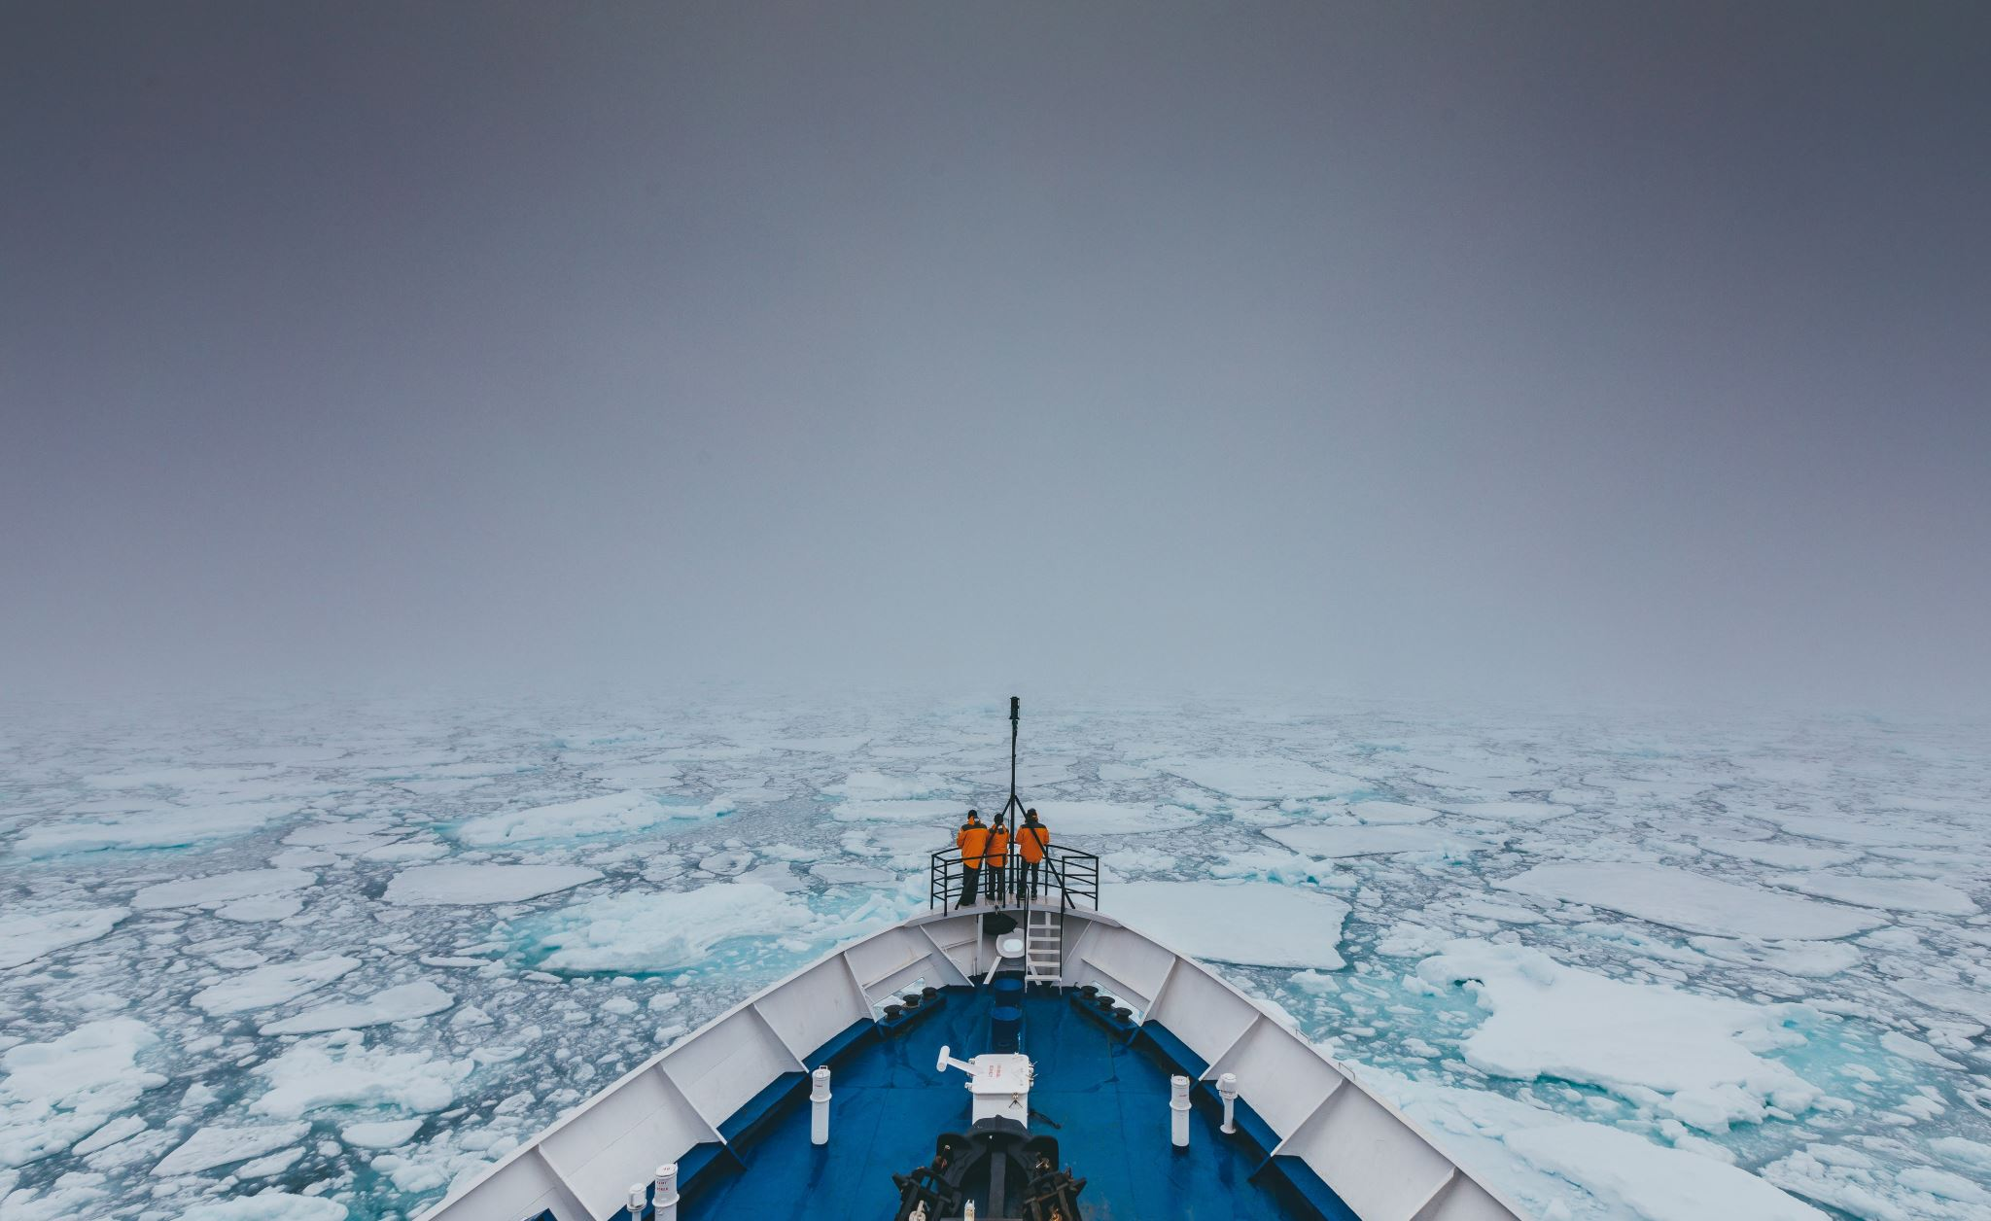
Oceans
Coast Guard Celestial is not like real life celestial. It's more like Pearson's class. Being more cracked in real life is not necessarily more helpful
The ditties you use may not work for other people, and vice versa, the most effective one is the one you invent, because of how the memory palace works.
Having a system for solving problems is more important than knowing answers.
Notes:
Malcolm
Unlike real-life celestial navigation, Coast Guard Celestial is more structured. Create your mnemonic devices for effective memorization and focus on developing problem-solving systems.

Slide 9
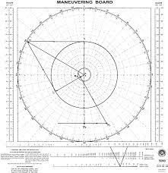
Terrestrial
Double check your answer bubbles, you can only get one question wrong, so don't swap two answers.
Picturing Failing while stressed causes failure.
You can calculate or you can draw, choose early which one to commit to, and don’t get fancy on the test
Notes:
Josh
Pay attention to answer bubbles, and if you're stressed, avoid picturing failure. Utilize your trigonometry knowledge to simplify plotting sheets and double-check your work.

Slide 10

The Generals (Nav Gen, Deck Gen, Deck Safety)
i) Studying
  (1) Go through the test once blind.
  (2) Review the questions you didn’t get right.
  (3) Try to find the answers to those questions from the texts.
  (4) Retake the test the next day.
ii) In the Exam Environment
  (1) Do the questions you’re confident in
  (2) Do the math ones.
  (3) Do the lookups.
  (4) Guess what’s left.
  (5) DOUBLE CHECK YOUR WORK
Notes:
Jake
Study blind, review, and retake tests to reinforce understanding. Prioritize confident questions, math problems, and lookups during the exam, and always double-check your work.
By following these strategies, you'll be well-prepared to tackle your Marine Transportation License exams with confidence. Remember, consistent practice and strategic preparation are key to success.

